Slide 1


Major Project-1 (CA301P) Odd Semester Session: 2025-26
Smart Learning Portal for Students
KUNAL SINGH - 2024101161001109
KUMAR KASHYAP - 202410116100106
KUNAL MALHOTRA - 202410116100107
LAVISH NEHRA - 202410116100111
Project Supervisor
Dr. Shashank Bhardwaj
Associate Professor
Ms. Neha Tyagi
Teaching Assistant
Mentor
Dr. Prashant Agrawal
Associate Professor

Slide 2
Introduction
Smart Learning Portal for Students
A Responsive E-Learning System with Regional Content, Adaptive Assessments, and AI Support for Underprivileged Learners
"This project aims to democratize education through an accessible E-learning platform with AI assistance, feedback, and smart content. It empowers underserved students by removing learning barriers and bridging the digital education gap."
The Need for Inclusive Smart Learning
Bridging the Digital Divide
Addressing Learning Barriers
Our Solution: Adaptive & Regionalised Learning
Over 40% of the global population lacks reliable internet access, exacerbating educational inequalities for underprivileged learners.
Limited resources, language differences, and engagement gaps hinder effective learning for disadvantaged students.
Our portal offers tailored content and AI assistance to overcome these challenges, fostering equitable access to education.

Slide 3

Literature Review
Trends & Challenges in E-Learning (2025)
Despite advancements, digital accessibility remains uneven, with a significant portion of learners lacking high-speed internet. This digital divide is a primary barrier.
Learner engagement often drops below 10% completion rates in self-paced courses due to passive content and lack of interaction. Platforms need to be more dynamic.
AI-driven personalisation and adaptive assessments are proving effective in improving retention and overall learning outcomes by tailoring content to individual needs.
Interactive and collaborative tools, such as those used by Lumio, have shown success in enhancing focus and providing timely feedback, crucial for student progress.

Slide 4
Project Scope
Key Objectives for the Smart Learning Portal
Universal Accessibility
1
Ensure the portal is fully responsive across all devices and network conditions.
Localised Content
2
Provide regionalised educational materials in local languages and curriculum.
Personalised Learning
3
Implement AI-powered adaptive assessments to tailor learning paths.
Offline Support
4
Offer offline capabilities and low-bandwidth optimisation for underprivileged learners.
Educator Empowerment
5
Enable teachers to track progress and provide timely, targeted feedback.

Slide 5




Technical Foundations
Hardware Requirements for Deployment
Backend Infrastructure
Client Device Compatibility
Cloud-hosted Node.js backend with a scalable MongoDB database ensures robust data handling and high availability.
Compatible with a wide range of devices, including smartphones, tablets, laptops, and low-end PCs, ensuring broad access.
Network Optimisation
AI Processing
Optimised for low-bandwidth environments, featuring offline caching and synchronisation for uninterrupted learning.
Utilises cloud-based AI services for adaptive assessments and intelligent chatbot support, enhancing learning interactions.

Slide 6
Technical Foundations
Software Requirements for Development
MERN Stack
AI Integration
Responsive UI
Full-stack development using MongoDB, Express.js, React.js, and Node.js.
Adaptive learning algorithms powered by TensorFlow.js or cloud AI APIs.
React-based, mobile-first design with Material-UI or Tailwind CSS.

Slide 7
System Design
Core Modules of the Portal
1
User Management
Robust system for registration, role assignment (student, teacher, admin), and profile management.
2
Content Delivery
Platform for regionalised course materials and diverse multimedia support.
3
Adaptive Assessment
AI-driven quizzes, detailed progress tracking, and personalised learning recommendations.
4
Communication Hub
Integrated chatbot AI for instant learner support and direct messaging between students and teachers.

Slide 8
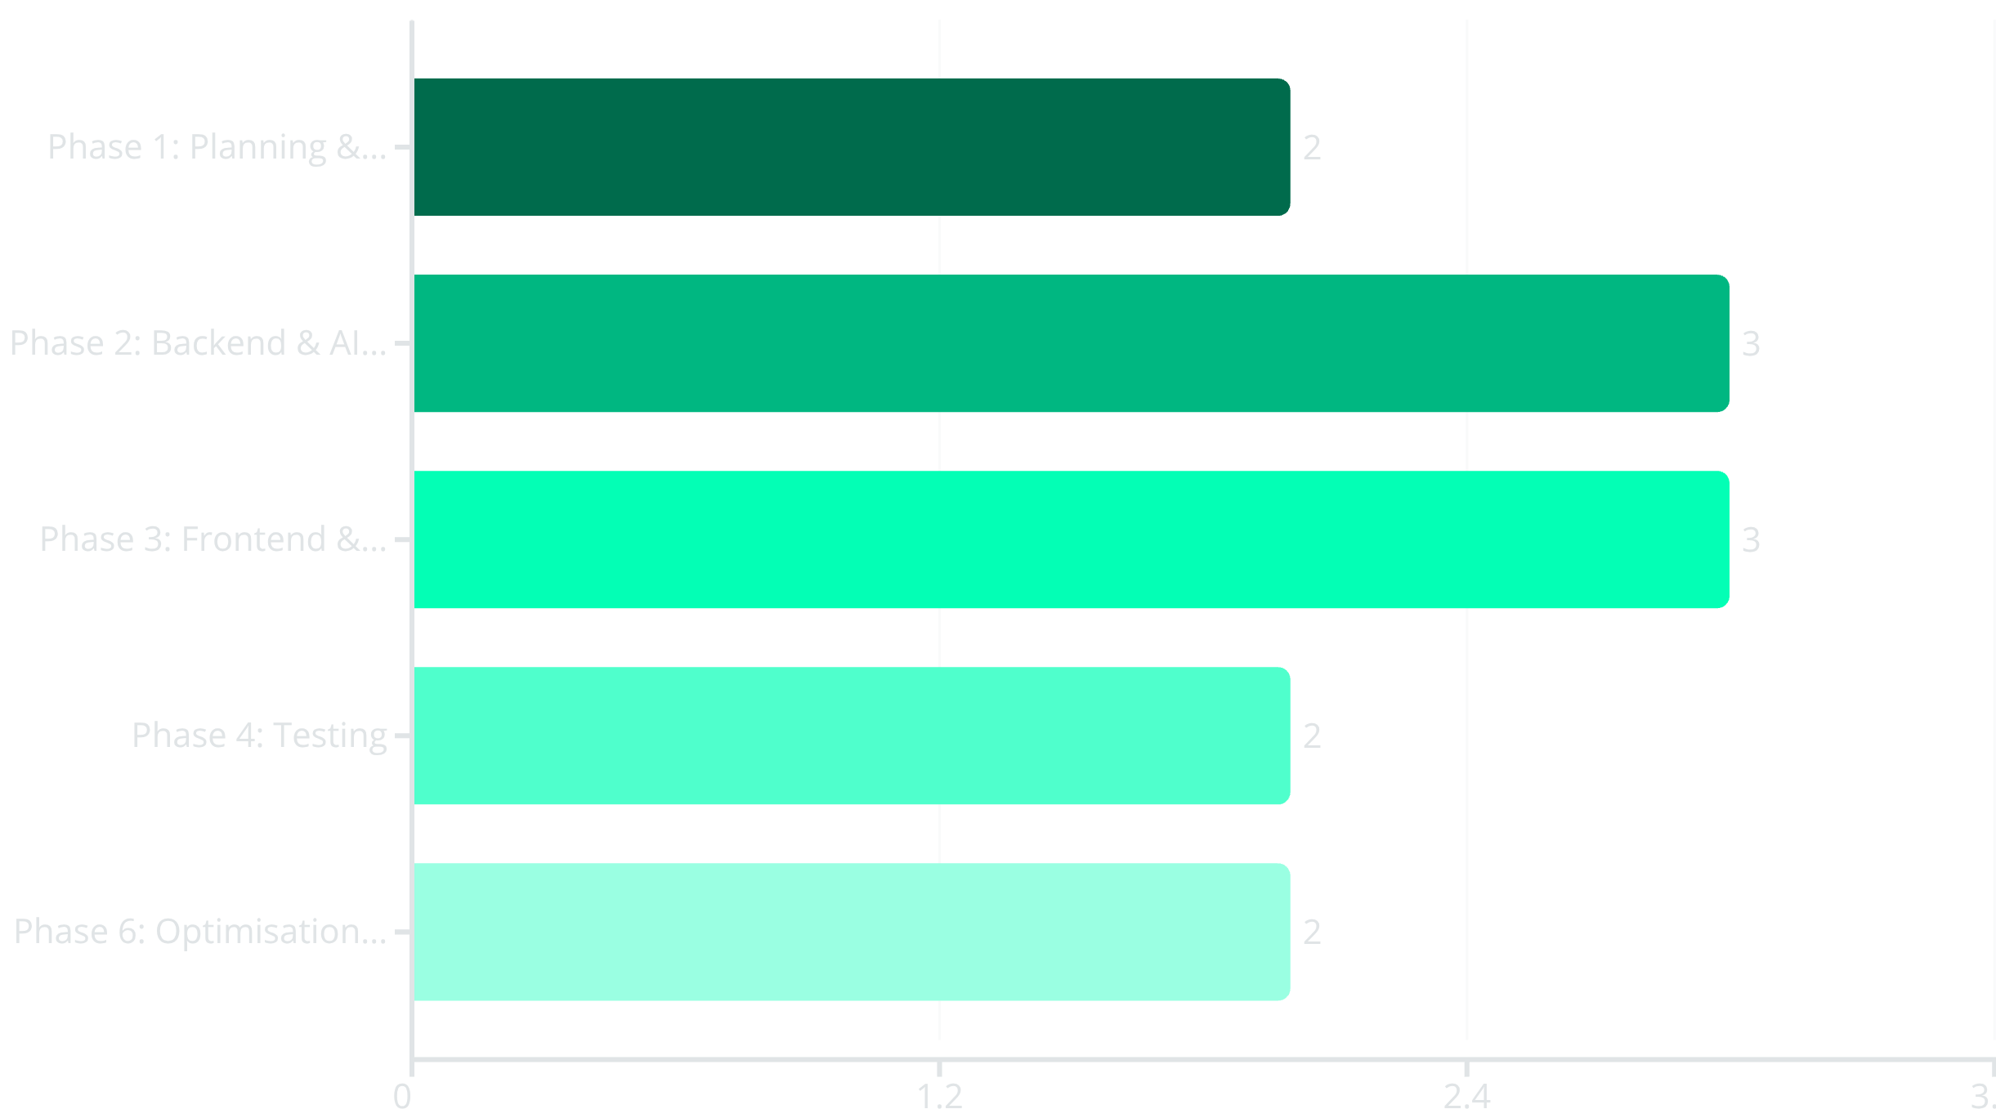
Project Planning
Workflow & Timeline (Gantt Chart Overview)
The project is structured into six key phases, each with clear deliverables and timelines. This phased approach allows for agile development, continuous feedback, and efficient resource allocation, culminating in a timely launch of the Smart Learning Portal.

Slide 9
Conclusion:
Transforming Learning for All
Our Smart Learning Portal is designed to empower underprivileged students by providing tailored, accessible education. Through the integration of cutting-edge AI, regional relevance, and crucial offline support, we aim to close digital divides and foster lifelong learning. Built on a scalable MERN architecture, this platform represents a significant step towards achieving equitable education worldwide.

Slide 10
Bibliography
UNESCO (2025). Global Digital Accessibility Report
MyDigiCode (2025). eLearning in 2025: Challenges and Solutions
Whatfix (2023). Best Learning Portals and Features
Lumio (2025). Interactive Learning Platform Case Studies
SPDLoad (2024). How to Build Your eLearning Platform
Skilljar (2025). Top eLearning Platforms and Technologies
GDPR & COPPA Compliance Guidelines (2025)
These references provide the foundational research and guidelines informing the development and strategic direction of the Smart Learning Portal, ensuring compliance, best practices, and alignment with future trends.

